Slide 1

Synchronize Ethereum data and develop a program to parse the block data files
Team Members:
Srikala Asam
Suraj Konangi
Faculty Coach Name:
Feng “George” Yu

Slide 2

Introduction
The project aims at developing an application that synchronizes Ethereum blockchain data, fetches block data files, stores the transactions in a file and provides an efficient analysis. This project aims to create a tool that allows users to efficiently download and store Ethereum blockchain data. Based, Throughout the project, several terms related to blockchain will be used.

Slide 3

Background
In the growing field of technology, there has been a significant growth in the web3 technology. Blockchain is part of web3, which in the near future, maybe adopted as a currency for most transactions.
Blockchain is basically a ledger that is shared and unchangeable (immutable), used to record transactions and assets within a business network (Zheng, 2018). In a business network, an asset refers to both tangible and intangible owned items. Example of tangible assets could include houses, cars, and land. On the other hand, intangible assets could include brands and copyrights. In a blockchain network, everything can be tracked and traded on. Blockchain is important as it avails information to businesses.
To begin with, if a transaction occurs, it is recorded as a block of data. This means that a block could have many transactions. Each transaction with different information from each other. The transactions track movement of assets within a network (Khan, 2021).
In the context of blockchain, it is important to discuss Ethereum. Ethereum slightly differs from blockchain. Ethereum is a decentralized blockchain business network. It allows developers to build and deploy AI contracts. Ethereum opens up a wide range of use cases.

Slide 4
Problem statement
Blockchain data is stored in unrefined disorganized formats. While its true that all the transactions are stored and cannot be immutable due to security concerns, there is a lack of emphasis on data analysis. Business decisions are made depending on available data in most cases, this typically means in a data driven decision business, having data generated from Ethereum (decentralized network) may not be enough. The proposed project in this case goes further by providing a way to access, analyze and interpret data within the blockchain network.

Slide 5
Methodology
The aim of the project was to come up with a tool that fetches Ethereum blockchain data through a network. Throughout the entire project, the following schedule was followed as the project was developed in an agile setup with each member contributing to the success of the project.
Week 1-2: Research Ethereum blockchain structure and data formats
Week 3-4: Implement Ethereum network synchronization
Week 5-6: Develop block data parsing functionality
Week 7-8: Create data storage and indexing system
Week 9-10: Implement basic analysis features
Week 11-12: Testing and optimization
Week 13: Documentation and Presentation

Slide 6
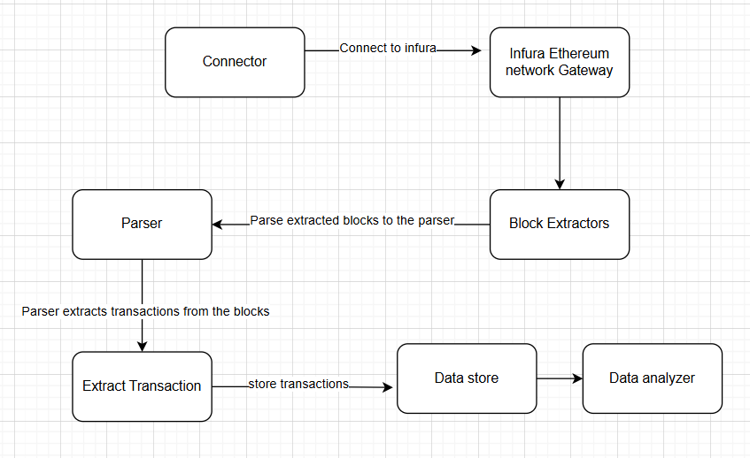
Methodology
The flow diagram below demonstrates the ideal flow of
data in the proposed project.
The chart shows the main component of the tools that was created.
Connector: - This is basically a connection bridge written in python.
The bridge connects to Infura Ethereum Gateway remotely, proving
a way to access resources from infra.
Infura Ethereum: - This is basically a gateway that connects to an Ethereum network. This will be the source of the blocks. It’s a real time gateway and also offers real world data. Below is a preview of the infura Ethereum dashboard.

Slide 7
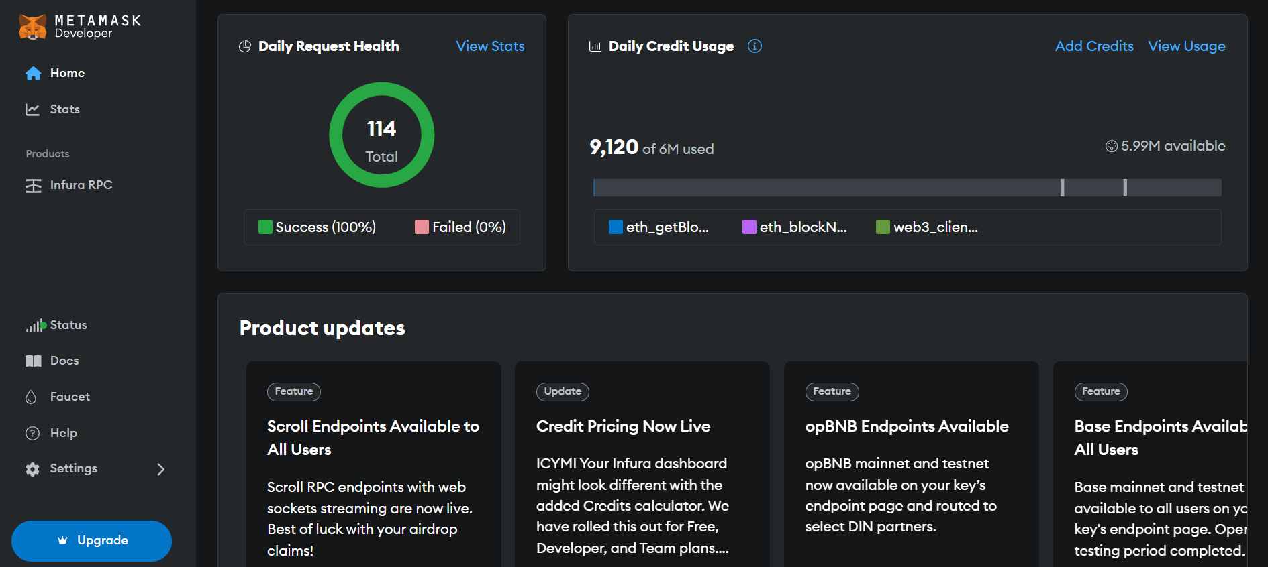

Slide 8
Methodology
Block extractors- This is a python file that stores the extract the blocks extracted from infura Ethereum. The blocks are then parsed to the parser for the extraction of transactions.
Parser: - The parse extracts the transactions from blocks parsed. And parsers the data the data store. In this context. The data is stored in a csv file. This is easier to access using pandas and create a data frame object.
Data store: - stores the extracted transactions in an excel format.
Analyzer: - Analyses the saved transactions giving useful visualizations.

Slide 9
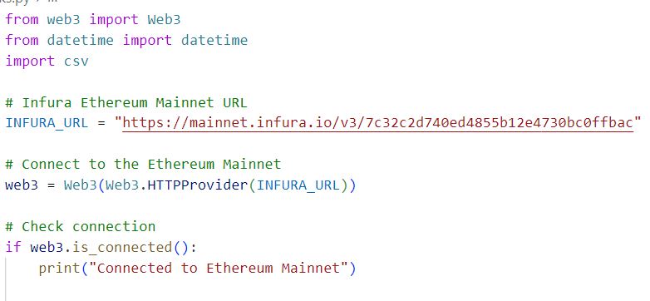

Experiments
The first experiment was trying to connect to infura gateway. After this connection, ideally it would be able to get the blocks, which contains transactions for analysis.
The code above attempts to connect to Ethereum, and here is the output. It connects to infura and fetches the latest block.

Slide 10
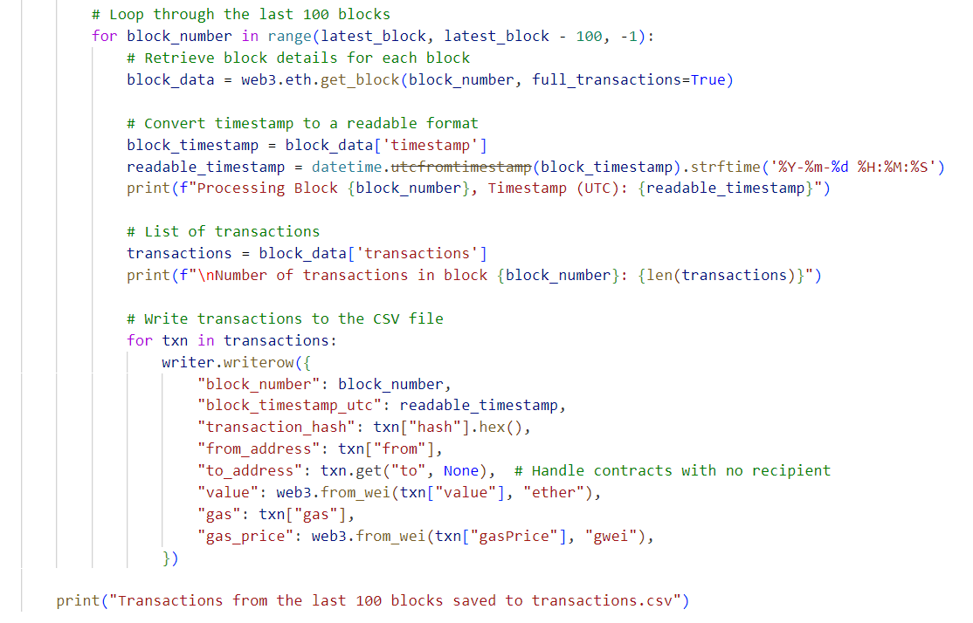
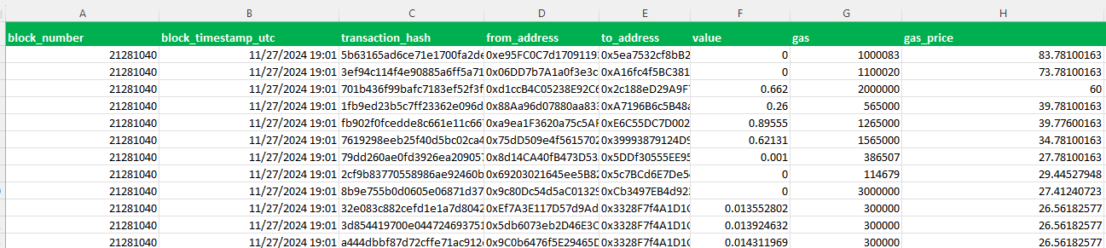
Experiments
Fetching data and saving it in an excel.
The second experiment before the analysis is
fetching of the data.
Initially, we are limiting to the last latest 100 blocks. As seen in this code.
The data is then parsed and stored in the excel sheet as shown in the format below.

Slide 11
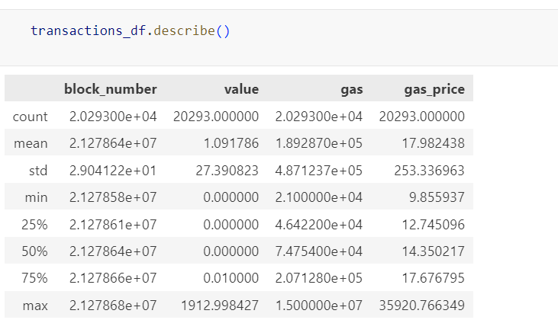
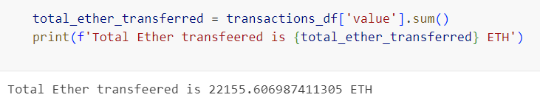
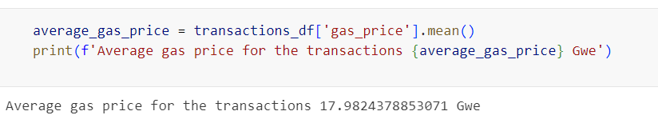
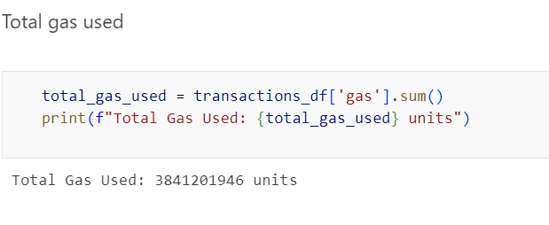
Important metrics for the blocks fetched
A summary statistic for the transactions based on the block Number are shown below , value, gas and gas price are shown below.
From the analysis of the transactions, we can obtain other important metrics. The metrics are shown below.
The total number of ethers transferred
Average gas price for the ethers transferred.
Total gas used.

Slide 12
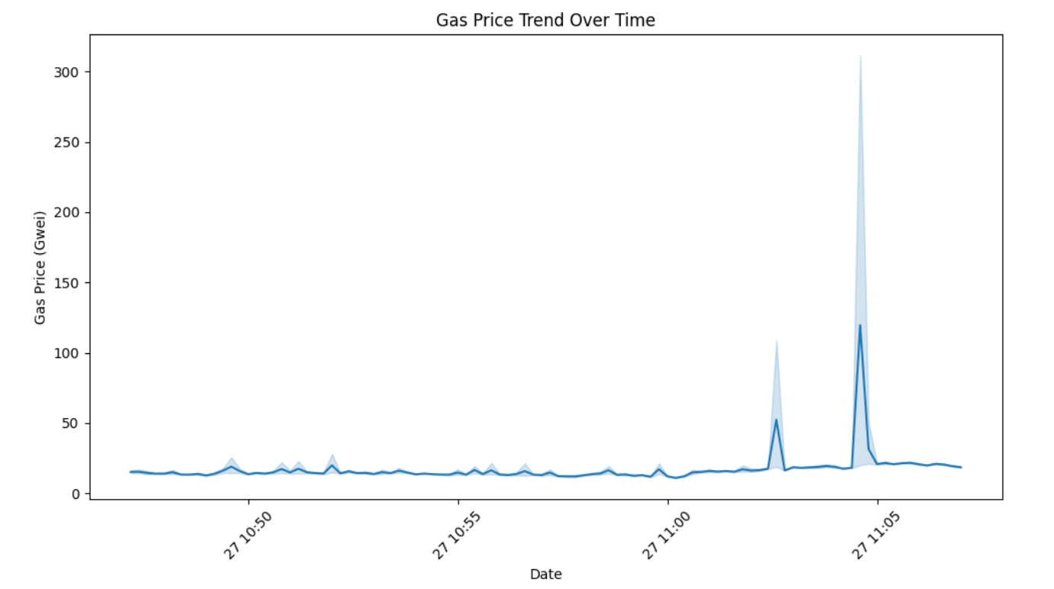
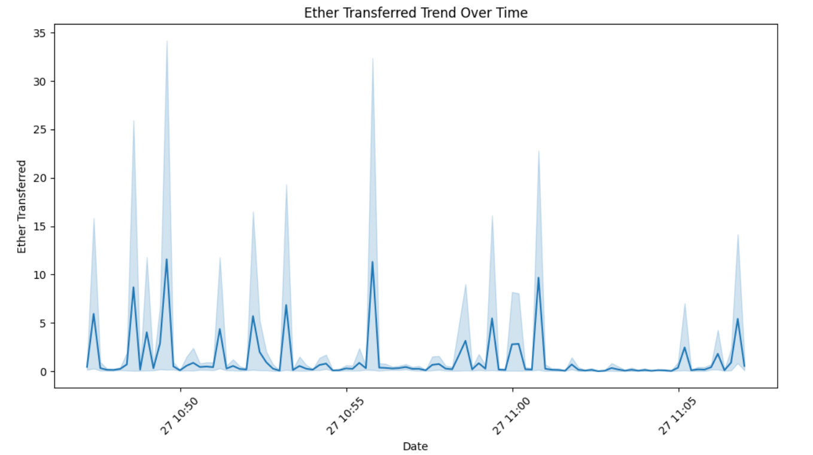
Visualizations
Further some visualizations based on the analysis are done. Below is a list of detailed visual charts based on the analysis done.
Gas price over the trend
Ether transferred over time

Slide 13
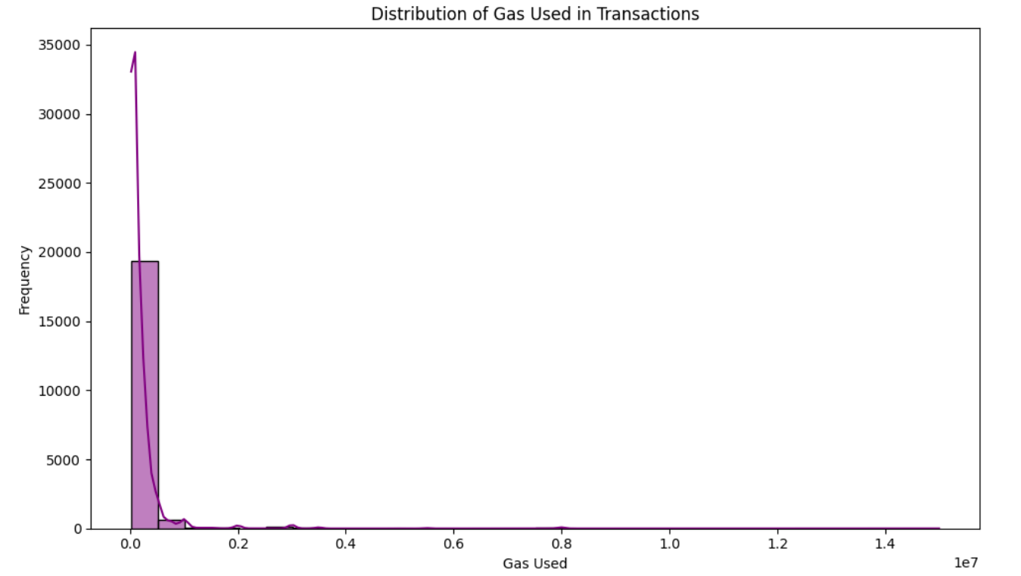
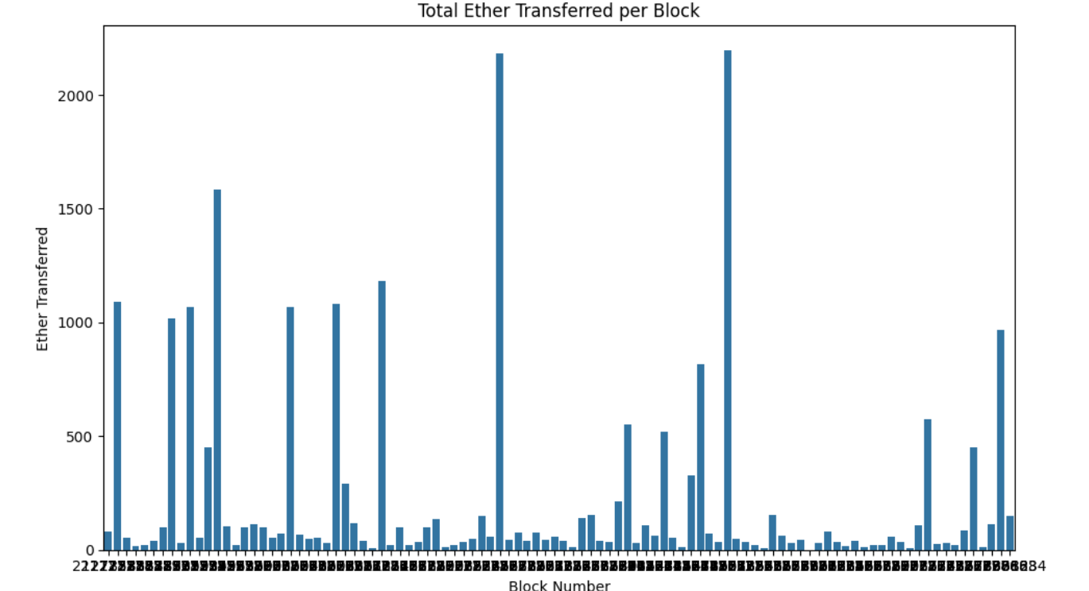
Visualizations
Average distribution of gas used per transactions. From the chat above, most transactions used an average gas of about 19000.
Total ether available per block fetched.

Slide 14
Conclusion
The project implemented successfully, allow users to efficiently download and store Ethereum blockchain data, then extract and analyze relevant information from the synchronized blocks. This is in line with the proposal. Further, it gives some analysis depending on the data fetched. To make the project effective, caching and data storage mechanisms are employed. Ideally, the analyzer fetches data from csv file. Uses python’s data science libraries such as pandas to transform the data to a data frame object and matplotlib and seaborn for plotting. In conclusion, the project demonstrates effective synchronization, parsing and analysis of Ethereum blocks.

